Slide 1

PPAMS
Ilia State University
CE490A: Senior Design Project A
Notes:
1st slide; introduction of the team

Slide 2

Team Members:
Jambuli Chkhikvadze
Samir Mansour
Giorgi Erkomaishvili
Notes:
Introduce the team and the members, nothing fancy here

Slide 3
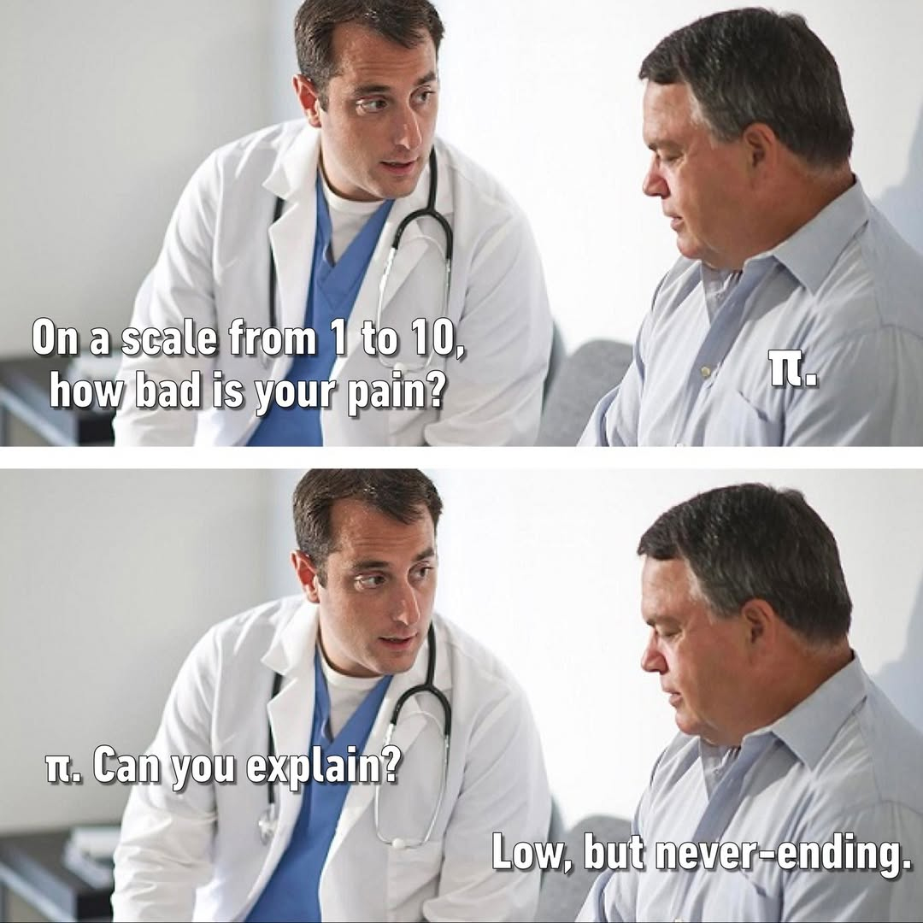

70-90% of people working office jobs experience low back pain!
Notes:
Speak about the problem briefly, a small joke to light up the mood. Always make it light, engaging, and not too forced. Ex: “a lot of us nowadays suffer from low back pain, but why is that?” and then go the 2nd slide, show this statistic and its link to office jobs and posture, reveal the punchline without talking about it giving the audience a sense of control when the speaker leaves it to the audience to read.

Slide 4



Our Solution? PPAMS
Posture Pillow Attachment Monitoring System
Removable chair attachment
Real-time monitoring
Gentle feedback
Habit self-correction
Notes:
Expand more on each bullet point, discuss how the market comes short when it comes to products like this, talk about the goal of the prototype, not too deep keep it light

Slide 5
How It Works…?
Smart hardware with a brilliant feedback system!
Sensors measure posture
Posture analysis through device
User sent an alert
App shows data and trends
Notes:
Briefly explain the process, sensors collect data, device analyzes the sent data, user gets an alert in case of deviation, all shows on the app showing habits and information about the day of your sitting. Also speak more about the alert thing, cuz we have a buzzer/vibration feedback to make sure that the idea isn’t too vague.

Slide 6
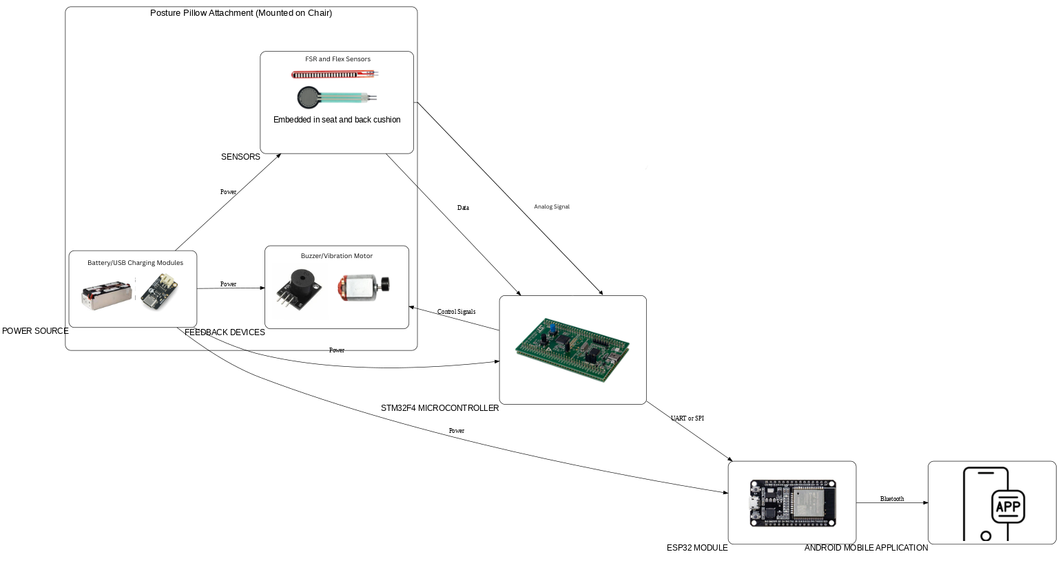
Device Diagram
SENSORS
MICROCONTROLLERS
COMPONENTS
Notes:
Samir slide, I just explain the main logic path for all the major components, nothing too hard. Make sure to make it as clear as possible without going into extremely detailed stuff

Slide 7
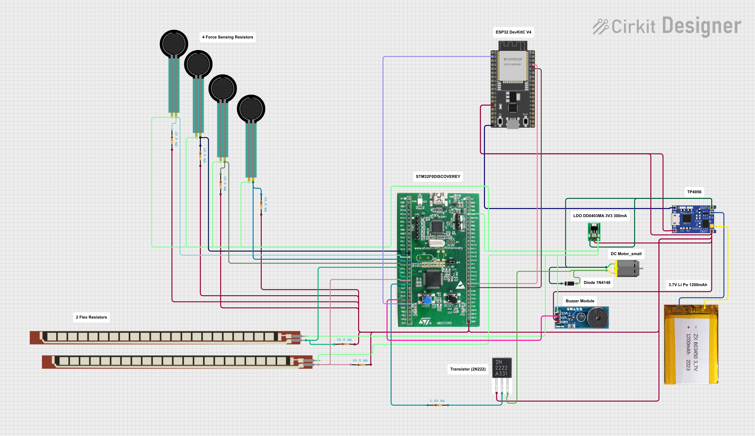
Electrical Circuit Diagram
Notes:
Jaba slide, talk about the circuit, how many volts we need, how many pins, why we use esp32, and most importantly voltage divider that allows the signal to move from the sensors to the stm32. explain the concept in a clear way to make the audience feel like they are also learning, getting something useful for their time besides only the project itself

Slide 8
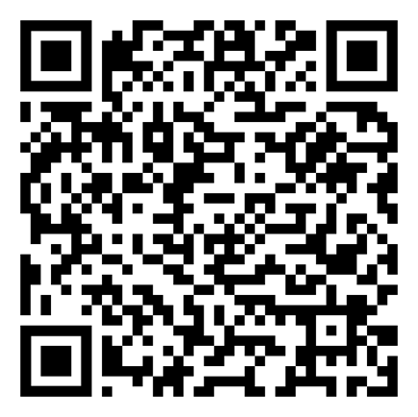
Electrical Diagram Project in details on your phone using this QR Code!

Slide 9
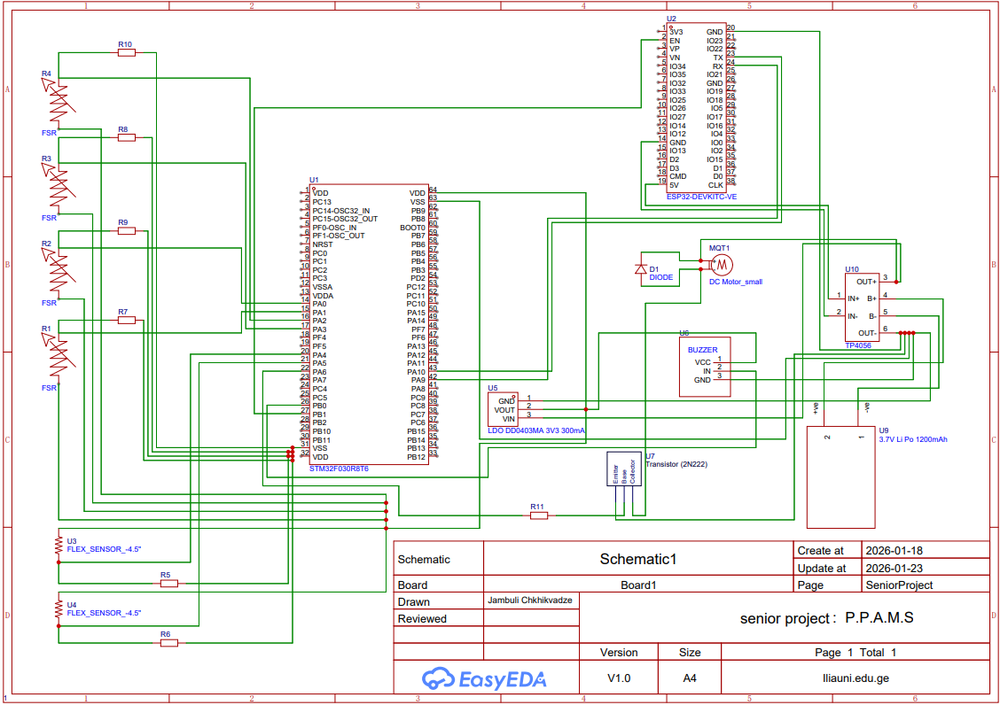
Electrical Schema

Slide 10
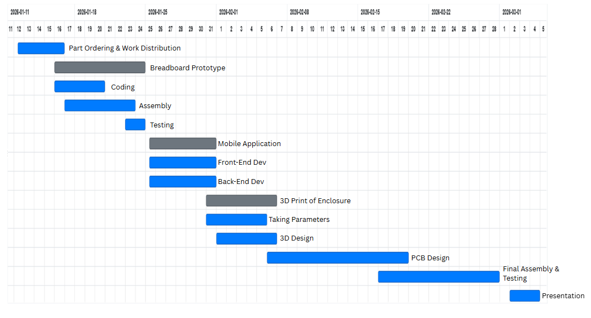
Gantt Chart

Slide 11
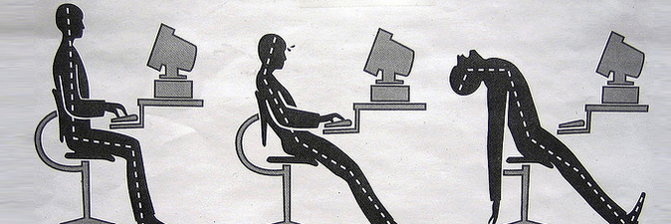
Calibration & Adaptation
Personalized posture baseline
User performs calibration session
System records correct posture
Live data compared to baseline
Ignore short deviations
Adjustable to different users and seating styles
Notes:
Gigi, talk about the calibration process, how the user adjusts their style of sitting in a way that the device is a perfect fit for all users and sitting methods. small illustration showing me or jaba sit on a chair in different styles and make believe calibrate button that shows the device’s way of knowing the posture, when it will give feedback, when it will not, and so on

Slide 12
Mobile Application
Visual history and trends of posture
Adjust alert behaviors
Android only currently
Calibration sessions through the app
Notes:
Same thing here, just more details into the app, how it will be accessible, available on what platform,

Slide 13
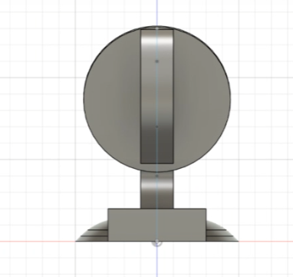
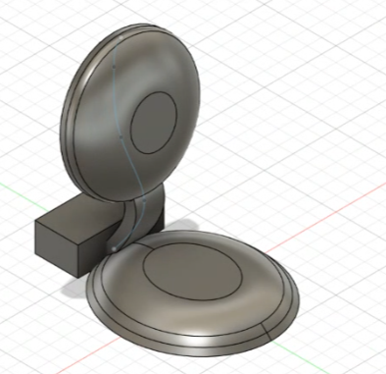
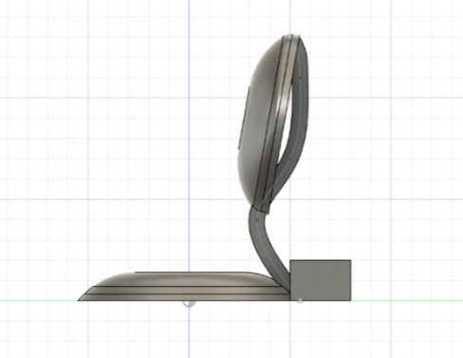
3D Device Diagram
Enclosure attached behind the lower back
3D pillow attachment on the seat
Removable for ease of use and cleaning purposes
Notes:
Display of the 3d model, explain the enclosure, what material we will potentially use, why we use it, also talk about the removable 3d printed pillow that prevents sensors from getting damaged, also the straps holding the enclosure

Slide 14
Engineering and Industry Standards
Bluetooth & Wi-Fi standards (IEEE 802.11 / 802.15)
ARM CMSIS for embedded development
Structured software and documentation
Electrical safety & EMC principles

Slide 15
Why This Project Matters?
Addresses a real, daily problem
User-friendly and non-intrusive
Encourages healthier posture habits
Designed for the modern office job
Notes:
This is pretty straightforward, just refer to slide 2 for the statistic and it’s done

Slide 16
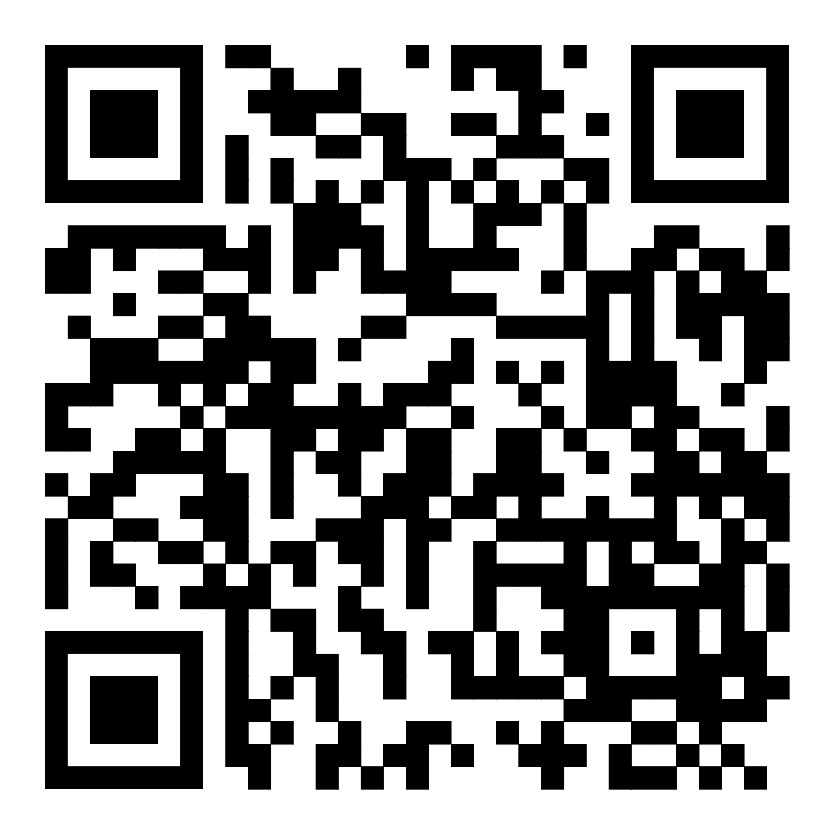
This is our Github Repository, includes more details and displays our team progress
Scan the QR code and check it out!
Notes:
Scan, nothing too fancy here either

Slide 17
Thanks for your attention!
Feel free to ask any questions!

